Slide 1
The Escape of Fredrick Douglas
According to the contextual clues given by Fredrick Douglass in his autobiography

Slide 2
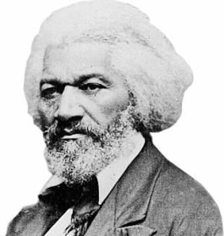
Introduction
Douglas has published how he escaped already
We chose to look for clues in the book to see if we could recreate his plan
The type of analysis that we did would be the same kind that a slave owner would use to track down runaways
By doing this we got a deeper understanding of the book and the hardships of a runaway slave

Slide 3
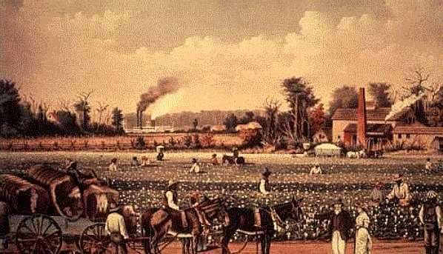
Historical Context
In the early 1800’s field hands began diversifying into specialized work
Anti slavery sentiments begin to become more prominent
1820 Missouri Comprise: drawing the lines between free states and slave states
In 1850, the nation literacy rate was .5%

Slide 4
The Escape Route

Slide 5
The Escape Route

Slide 6
Company
He most likely travelled alone
Reasons for this are directly in the book

Slide 7
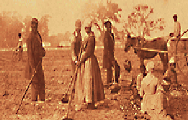
Clothing
He would have worn the clothes that he was provided as a slave.
When he was living in Baltimore, he had clothing provided to him.
He most likely traveled with just the clothes on his back.

Slide 8
Food
His food was provided from his master so this would have been the his main source.
Also before he left Baltimore he was working at a shipyard, and his master allowed him to keep some of his earnings. This would have helped him buy food on his journey.
Douglas also admitted that he was not above begging or stealing to survive.

Slide 9
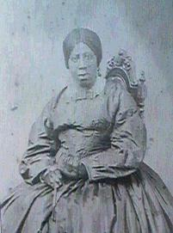
Connections
Douglas would definitely need assistance in his journey. The people he met as he travelled from ownership to ownership would have been able to help.
Since he planned to travel by sea, the captain he met could have been very helpful
He also had many friends in Baltimore that could have him escaped the city

Slide 10
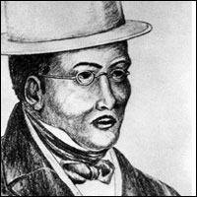
Connections
The two biggest contributors were discovered after he left Baltimore.
Mr. Ruggles housed him in New York and helped him find safe location to travel to.
Mr. and Mrs. Johnson helped him find work and fed and clothed him when he settled in New Bedford

